Slide 1
ALGORITHMS IN SOCIAL MEDIA AND ITS MENTAL HEALTH EFFECTS
Eda Gokdogan

Slide 2
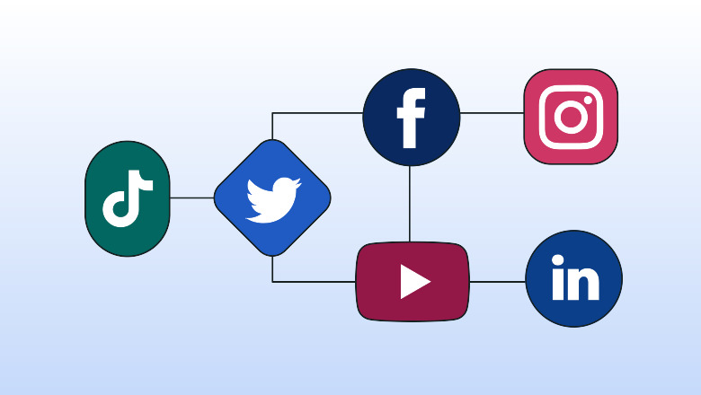
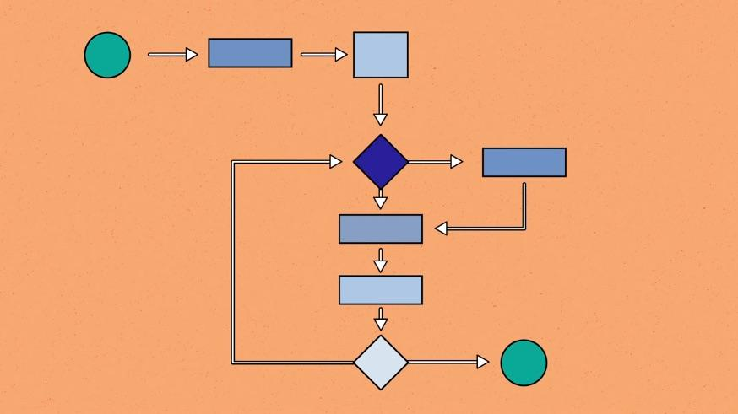
Algorithms Review
Algorithms in class we defined as a set of instructions to perform a task.
It acts as an exact list of instructions that conduct action step by step to create some output
It is used throughout all areas such computer science, mathematics, automated systems
In this context, the algorithm used as recommendations for user content on social media
The social media environment makes algorithmic decision making using computer programs with massive quantities of data about each user in order to deliver content that user could find it engaging

Slide 3
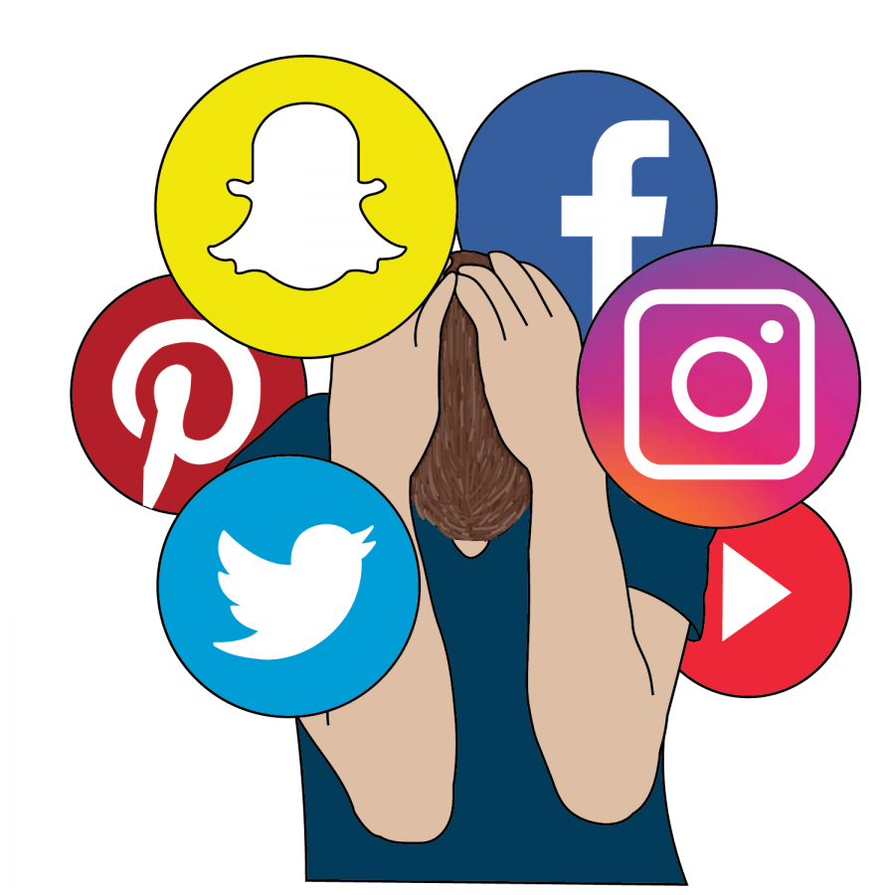
Background
The goal of my project is to examine social media and mental health by investigating the correlation between the social media usage and its impact on mental health
It aims to address computer algorithms and the content people see on social media. The research mainly focuses on the age group from 18 to 29.
Researching whether Algorithm-Driven content shown on the social media to maximize user engagement could lead to involvement of comparisons, feeling of inadequacy and depression.
The research examines whether social media usage has an effect on mental health variables. These variables show the reflections of users' interactions with social media platforms and its psychological effects of the interactions
The data that I used was from Kaggle called Social Media and Mental Health by Souivik Ahmed

Slide 4


Research Question
How does social media users feel while using social media platforms? How are algorithm driven content on social media and mental health related with each other?

Slide 5
The Questions Asked in the Dataset
How often do you find yourself using social media without a specific purpose?
How often do you get distracted by Social media when you are busy doing something?
Do you feel restless if you haven't used Social media in a while?
How easily distracted are you?
How much are you bothered by worries?
Do you find it difficult to concentrate on things?
How often do you compare yourself to other successful people through the use of social media?
Following the previous question, how do you feel about these comparisons, generally speaking?
How often do you feel depressed or down?
How frequently does your interest in daily activities fluctuate?
How often do you face issues regarding sleep?
Notes:
Some of the questions that are given that I conducted an experiment with
The main purpose for selecting these questions was whether algorithms of showing emotional or influencing content make the user feel like inadequate or depressive

Slide 6
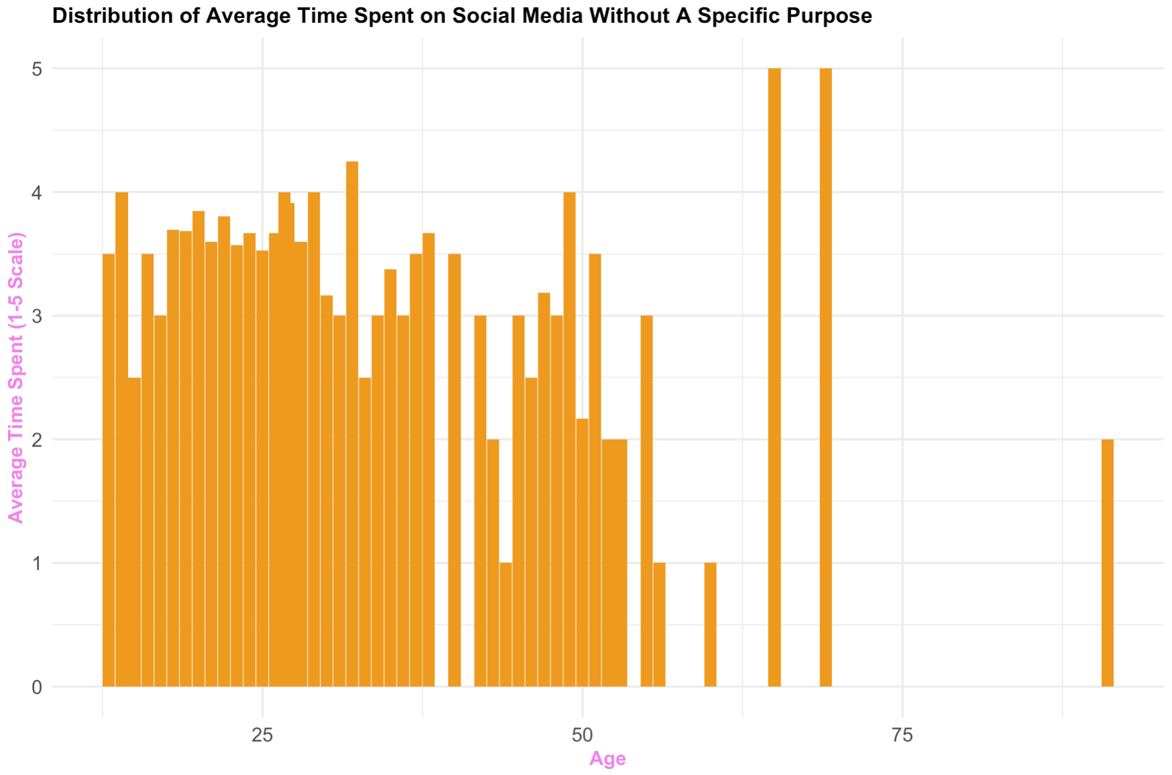
- By using the ggplot package for creating a chart, draw the age group from age 13 to 99 and the time that they spent on social media without a specific purpose.
- The result supported that time spent on social media without specific purpose is frequent in age group in ages between 18 and 29.
- There is a high frequency of users that spent time on social media without a specific purpose.
Methods/Findings
Notes:
I filtered the data using dplyr package and created a graph using ggplot and found out that

Slide 7
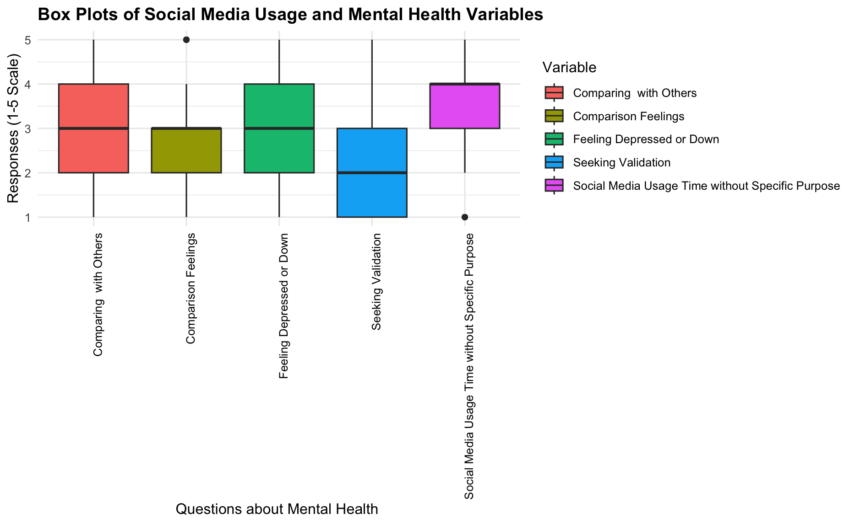
The box plot shows that there is a high indication that the social media usage creates comparison with others, makes user feel negative about this comparison and leads to feel depressed and down.
The highest effect of social media usage is feeling depressed on social media, with the average of 3.25 out of 5.
Methods/Findings
Notes:
I filtered the data using dplyr package and created a graph using ggplot and found out that

Slide 8

Key Takeaways/ Results
The bar chart for social media usage shows how often users engage with social media without specific purpose. High engagement levels without specific purpose could show that the algorithms are forcing the user to engage with the platform.
The algorithms that prioritize highly popular content could lead users to compare with others on social media.
The box plot for feeling depressed indicates the self-reported frequency of depressive feeling among users. There is an association with social media and algorithms that expose users to content that triggers negative emotional feelings.
Algorithms create echo chambers by filtering content that aligns with a user’s views and interest, excluding diverse perspective. This could intensify the emotional impact of content and increased comparison and mental health issues.
There needs to be further investigation on the data due to 50% accuracy that I conducted using both decision tree and glm modeling and high subjectivity of the topic.
Notes:
These are not 100 percent accurate datas. The results according to the machine learning tests are suggesting 50% accuracy due to high subjectivity of the topic.

Slide 9
Thank you for listening
Notes:
I filtered the data using dplyr package and created a graph using ggplot and found out that

